Slide 1

Internal Ism auditor Micro Credit Course

Slide 2
Internal ISM auditor course
Aim: Every ship and shipping company is bound to follow the ISM code.
One of the element of ISM code is auditing of the ship;
This value added MCC course will provide sufficient exposure for auditing procedure.

Slide 3

1
Purpose of audit
To identify the existence of
safety standards
2
Systematic approach for audit
How to go in chronological steps

Slide 4
Importance of Internal audit
It is mandatory by the ISM code: Every ship must undergo with internal ISM audit. Audit is a tool to ensure vessel is up to date for safe operation.

Slide 5





Objective-IMU to lead in giving outstanding knowledge to future ISM Auditors

Slide 6




Unit 1
International Safety Management is for the safety of shipping

Slide 7






ISM is an IMO code.
Background
ISM entered into force in year 1998 and became mandatory to shipping as it was incorporated in SOLAS chapter-IX in year 1994.

Slide 8


Implementation of ISM code in shipping office as well as on the ship ensures Enhancement in safety in multifold.

Slide 9

ISM Internal Auditor function is to audit the ship or shipping organization with extreme expertise observing compliance with each elements of ISM.

Slide 10





Unit 2
Procedure to conduct ISM internal Audit
Internal auditor should conduct the opening meeting with management and subordinates.

Slide 11





Unit 2 continues
ISM auditor will discuss with management and subordinate the Audit
schedule and plan;
  Once plan is delegated then start executing the plan;
ISM auditor will check that company is having safety and environment
protection policy

Slide 12





Unit 2 continues
ISM auditor will check that Safety Management system is in existence;
  Following Manuals should be on board:
See in next

Slide 13


1
Checking of vessel’s documents
2
Checking of Safety management
system
.

Slide 14
Reasons for acciden^{Co}t^{lu}s^{mn1}
2
10%
88%
human error
machinery failure
act of god

Slide 15

Contingency Handling Manual
Safety and Quality Manual
Health and Hygiene Manual

Slide 16

Fleet personnel Manual
Operation Manual
Technical Manual

Slide 17
Inspection of statutory certificates;
Inspection of Safety registers; Inspection of cargo gears; Inspection of other certificates.

Slide 18





ISM Internal Audit continues
Section 1 Check the drill records

Slide 19


1
Inspection of drill records
.
2
Inspection of drill manuals
,

Slide 20








ISM Internal Audits Continues
Section 2
Audit of records that Onboard /organization
Safety movies had been screened
Regularly.

Slide 21
Physical verification of various bridge equipments.

Slide 22


1Bridge equips
All ok
2Any observation
record
3
Any NC record

Slide 23
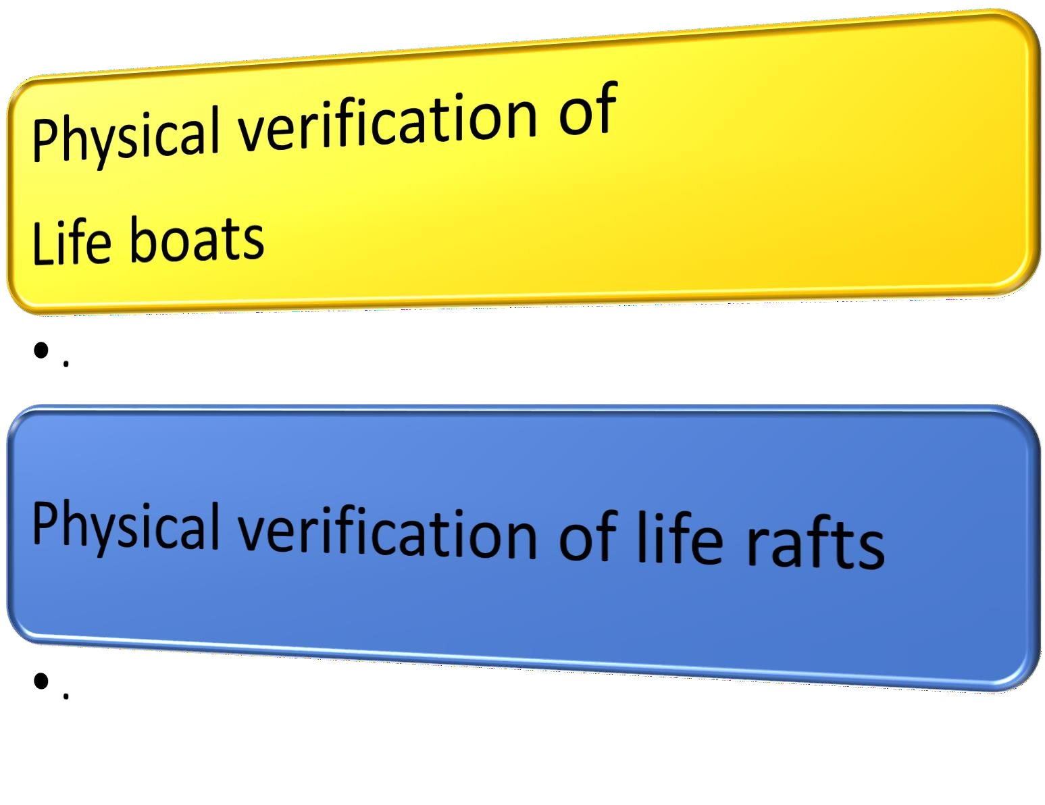

Slide 24


Verification of safety posters
•.
Verification of safety signals
•.

Slide 25
Verification of main deck method
Verification of forecastle deck method
Verification of poop deck method

Slide 26










No observation :Good ship NC /observation found Need corrective action Give time period of 1month.
Result
Internal Audit continues
Audit for Physical inspection
of the vessel/ organization.

Slide 27
Verification of ER (method)
•.
Verification of safeties in ECR
•.

Slide 28




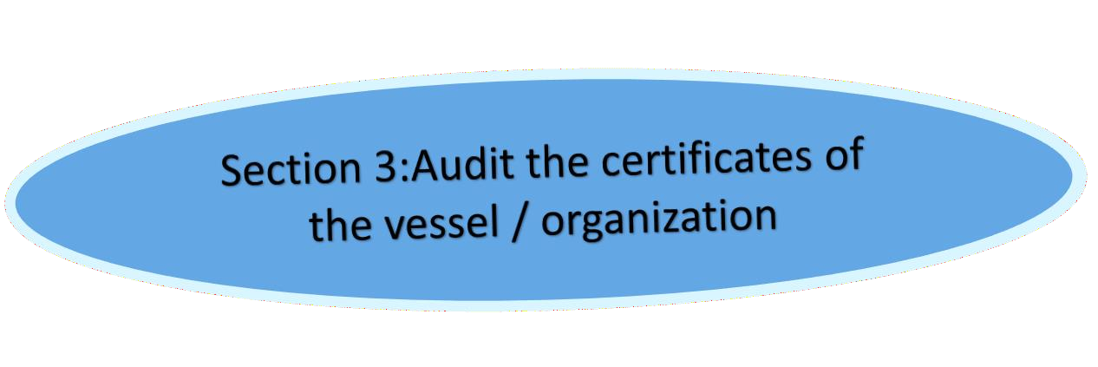
Unit 2 Continues
No Observation
ISM Internal Auditor
NC/
Observation

Slide 29


Internal Audit
Close up meeting with captain, CE and other Management subordinates.

